Slide 1

Internal Marks Calculator
18Z207 – Arun Prasad P
18Z209 – Arun Mozhi P
18Z234 – Navenkumar D
18Z244 – Salmaan Khan M
18Z251 – Sivaraj J

Slide 2

PROBLEM STATEMENT
Collect details of every subject (Minimum 5 Subjects and 2 Lab) for a semester.
Compute internal marks.
Display internal details with split up for each subject.

Slide 3

Design
Theory Courses
Get Marks for 5 Theory Courses
Lab Courses
Get Marks for 2 Lab Courses
Display Marks
Display Lab and Theory Marks

Slide 4
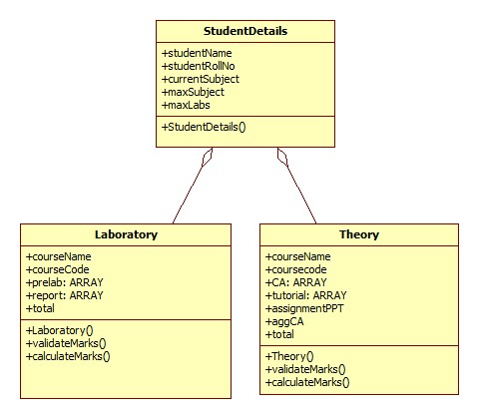
Class Diagram

Slide 5
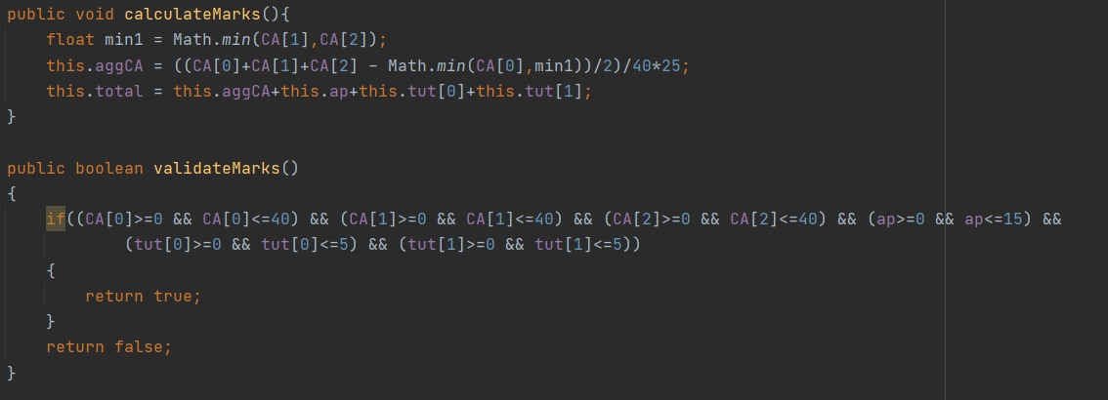
Function Definition

Slide 6
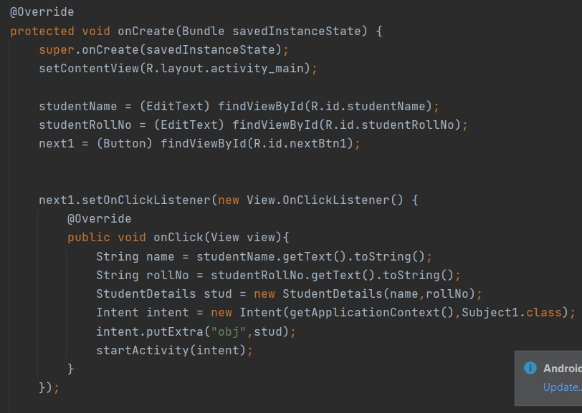
Main Activity

Slide 7
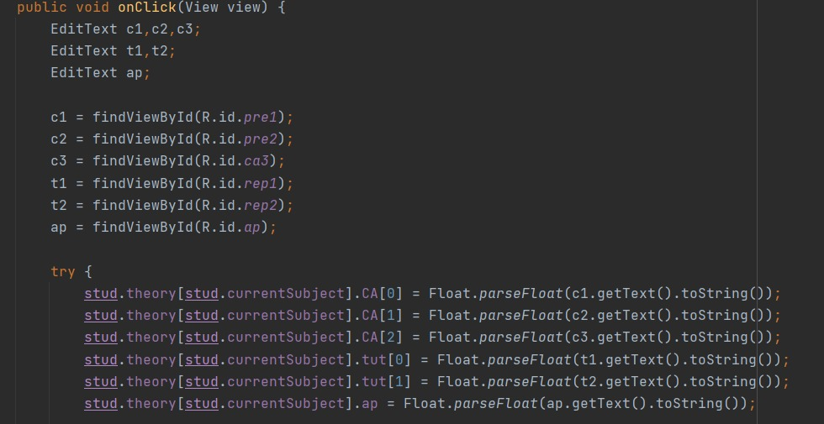
Theory Activity

Slide 8
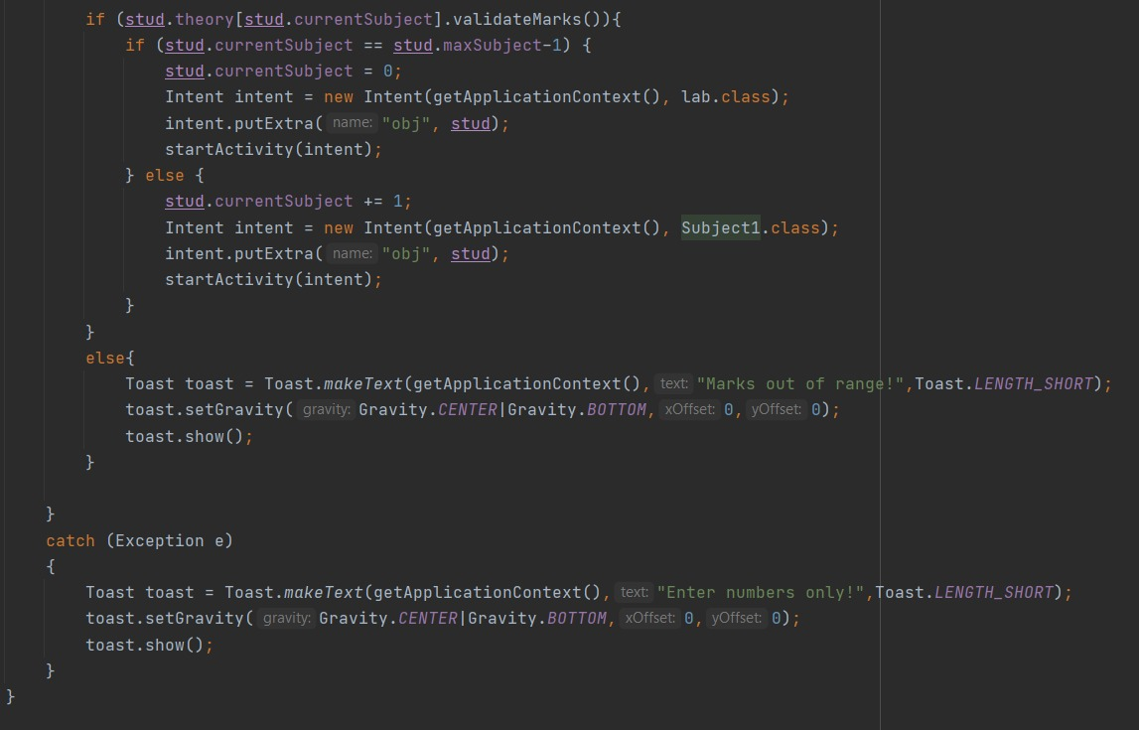
Theory Activity

Slide 9
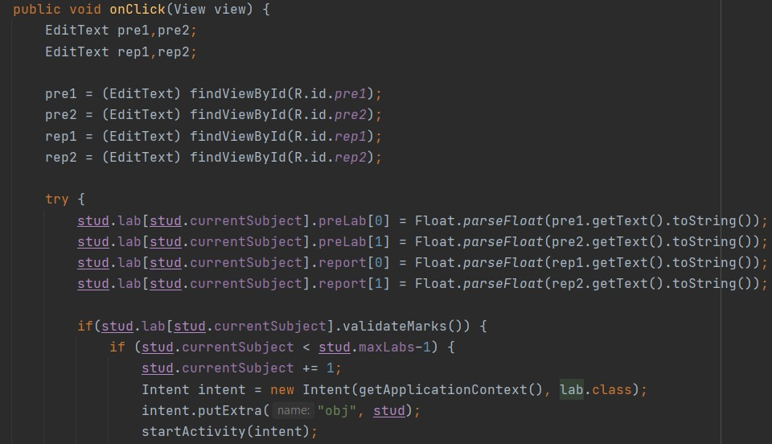
Lab Activity

Slide 10
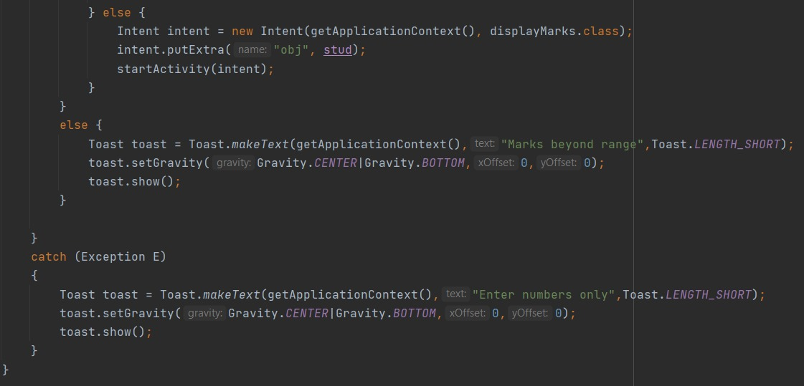
Lab Activity

Slide 11
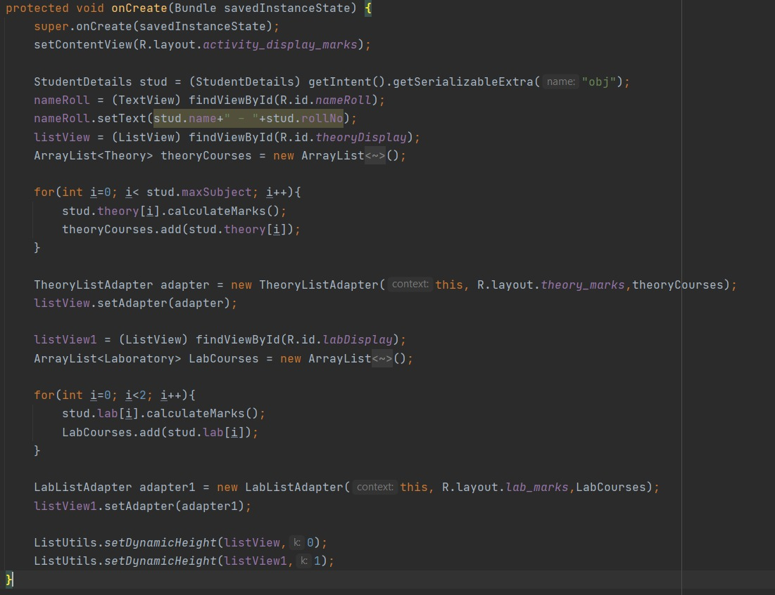
Display Marks

Slide 12
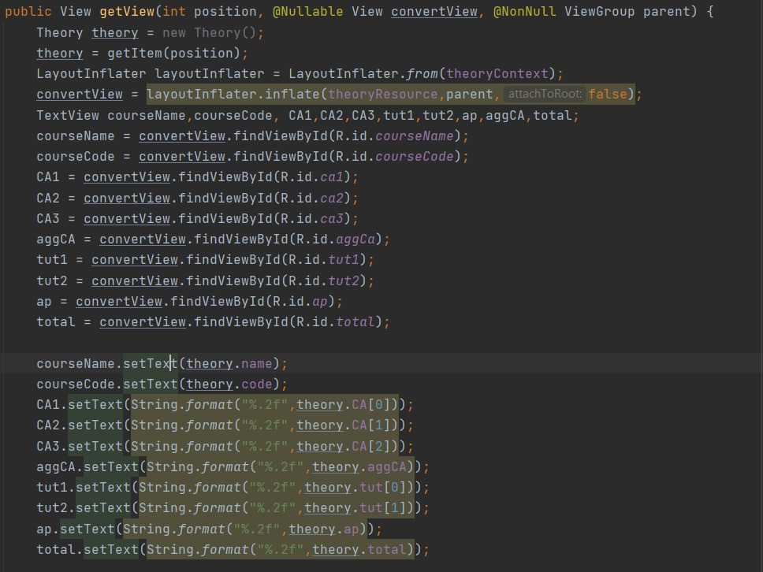
Theory Adapter

Slide 13
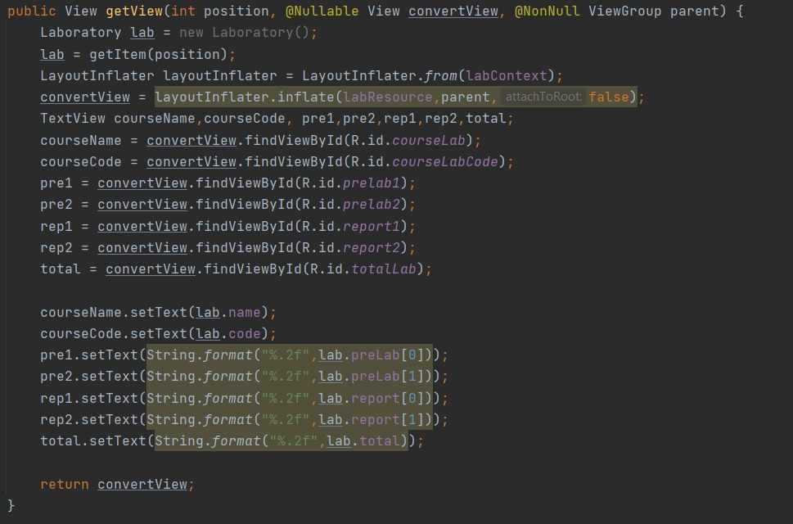
Lab Adapter

Slide 14

Demo

Slide 15
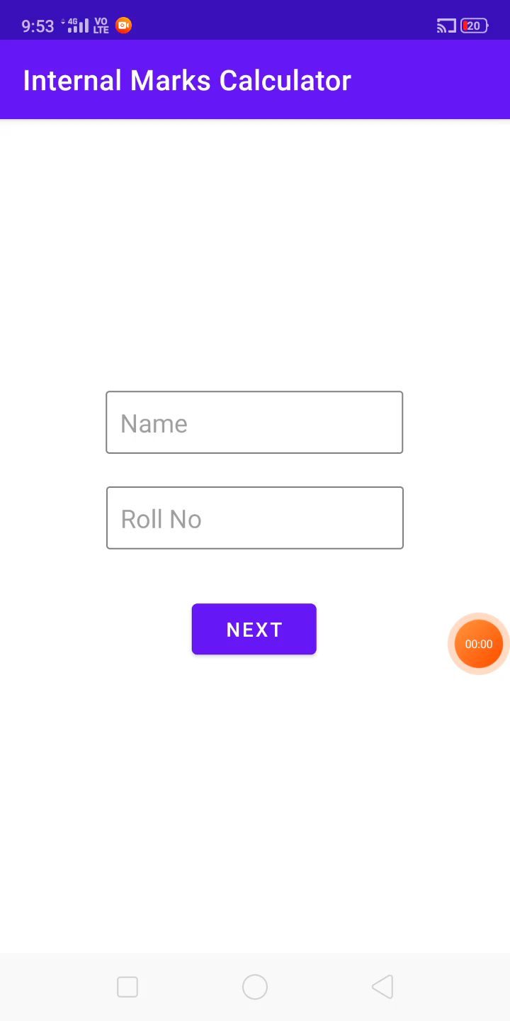

Slide 16

Thank You

